Slide 1
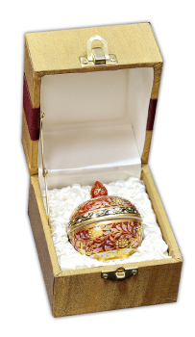
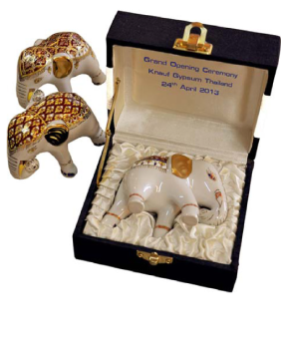
Juk-Nom mini casket size : H 6.5 x W 5.4 cm
Box size : 9x10x8.5
Price 290 THB
Mini ELephant size : H 7 x W 10 cm
Box size : 12x10x6.4
Price 380 THB

Slide 2
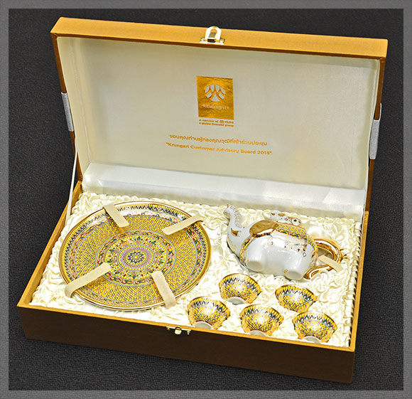
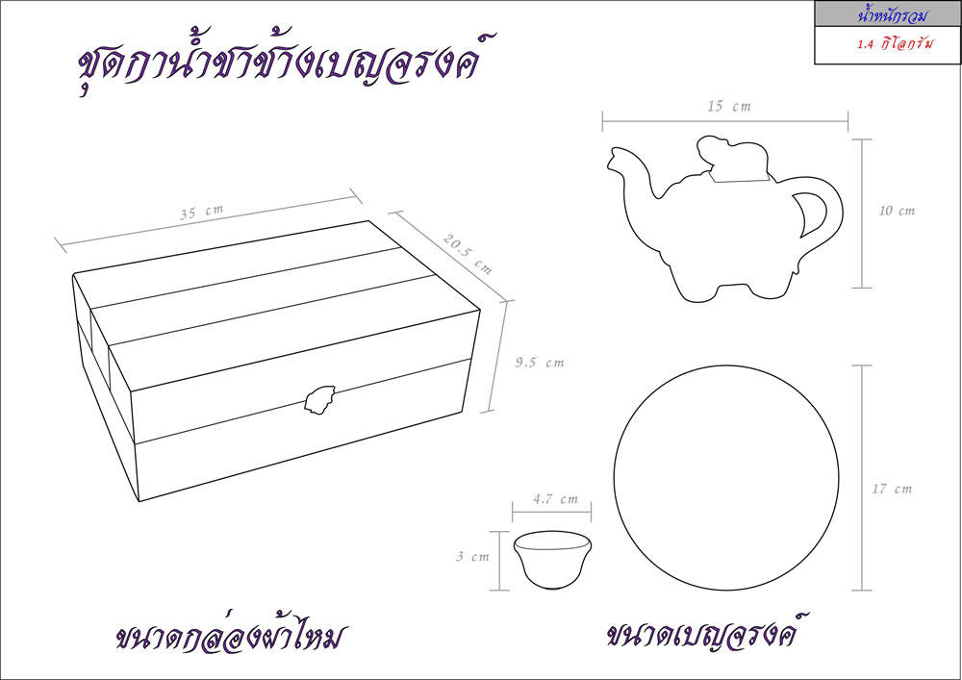
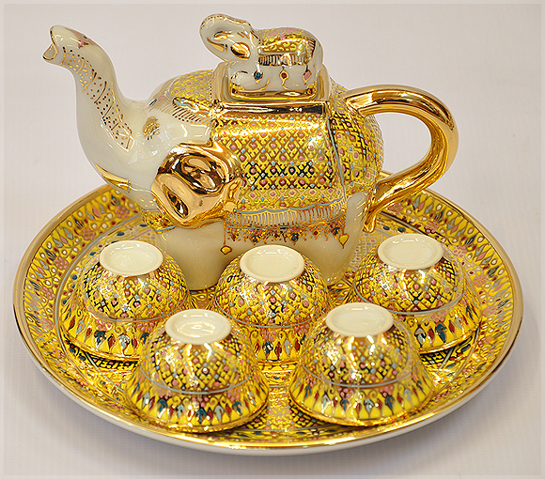
Elephant Teaset Price : 2,250 THB

Slide 3
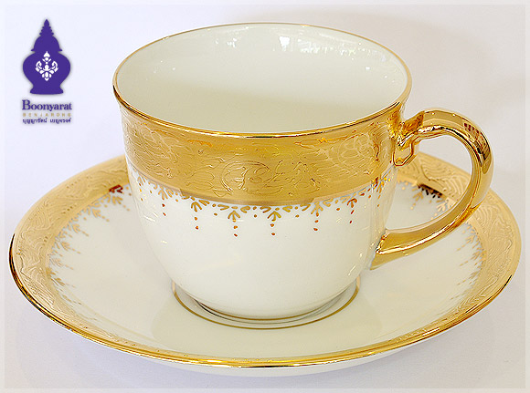
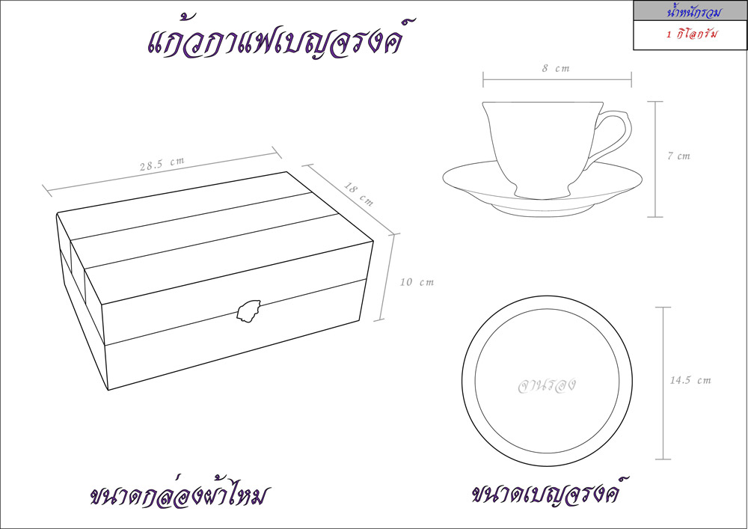
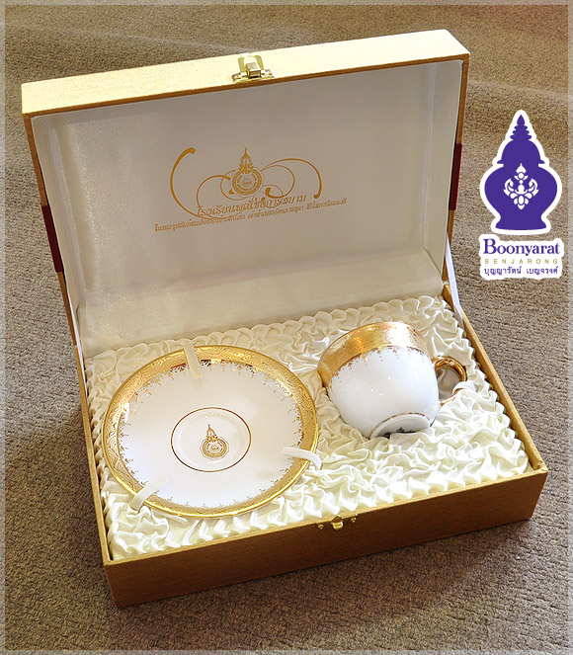
Benjarong Coffee cup Thong-Noon Pattern Price : 870 THB

Slide 4
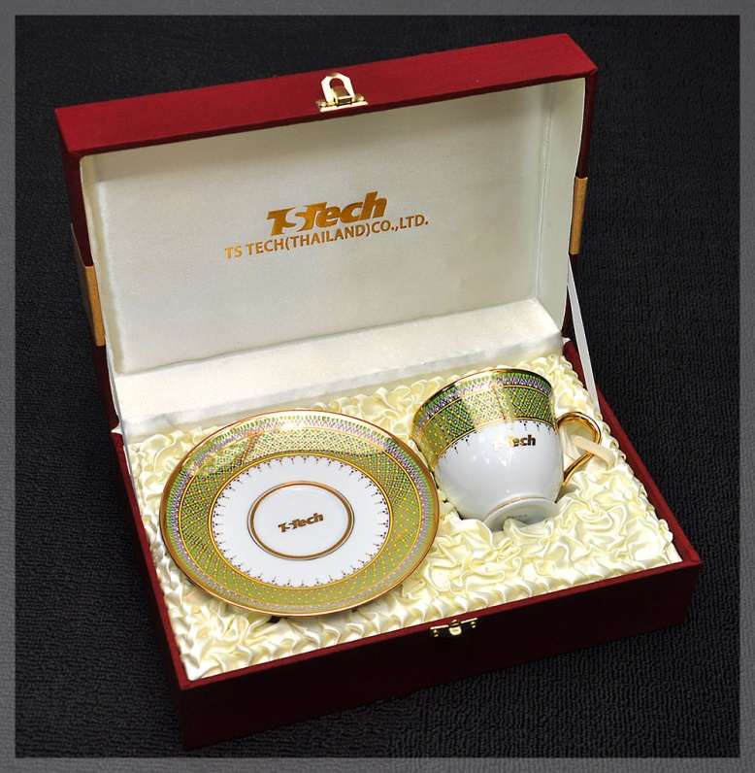
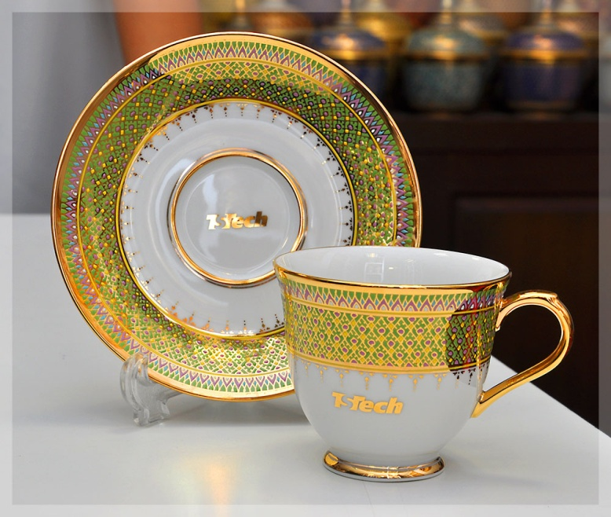
Benjarong Coffee cup Yod-tien Pattern Price : 1,250 THB

Slide 5
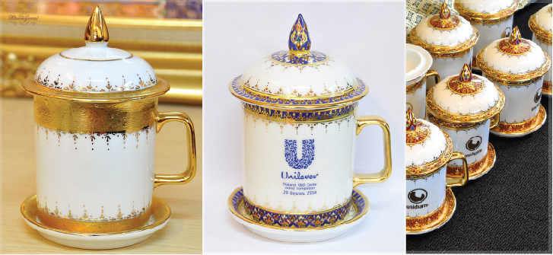
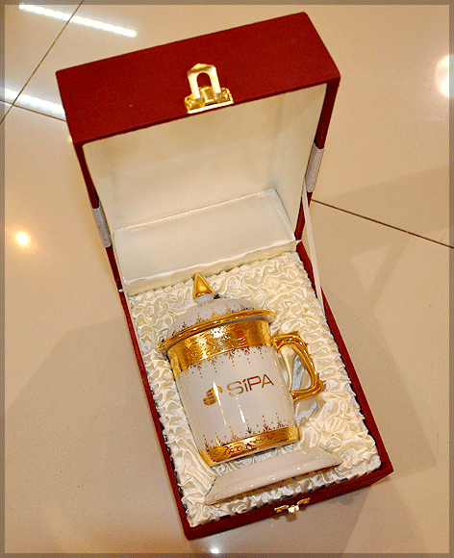
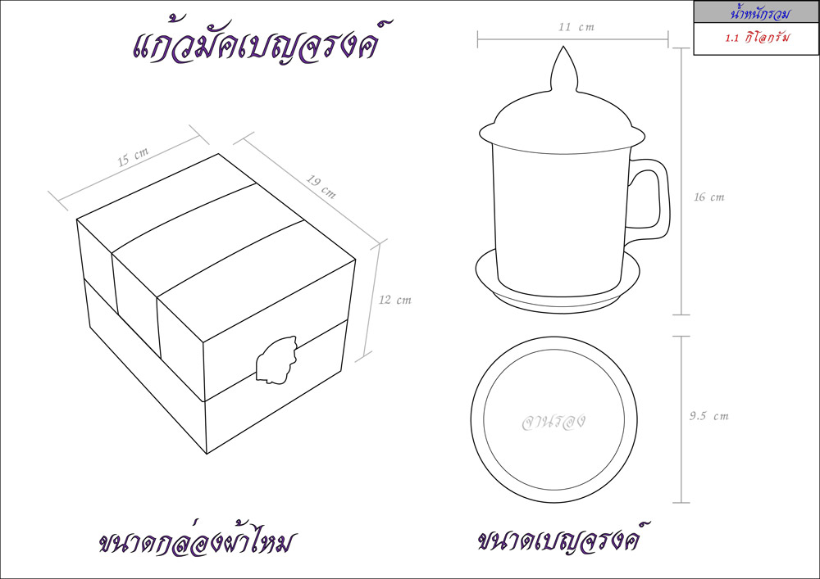
Mug Thong-Noon pattern Price : 870 THB

Slide 6
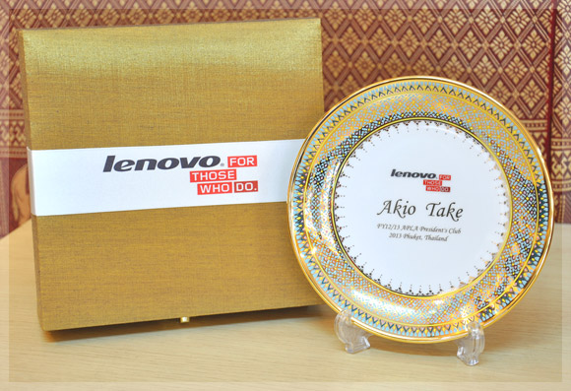
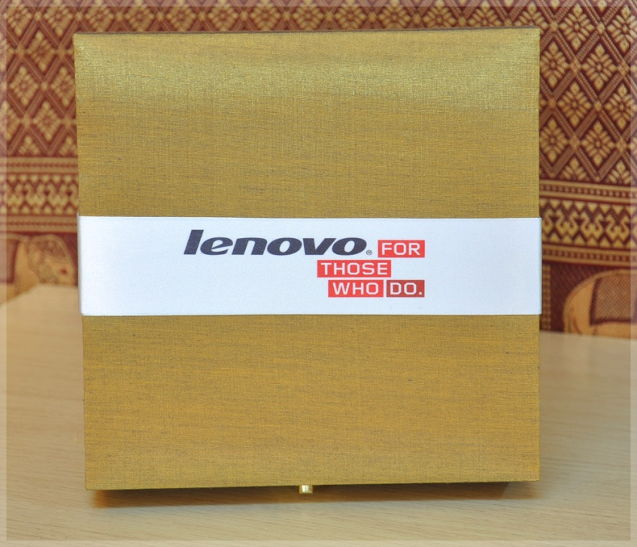
Show plate size 6.5 inch Price range: 1,400 – 2,700 THB

Slide 7
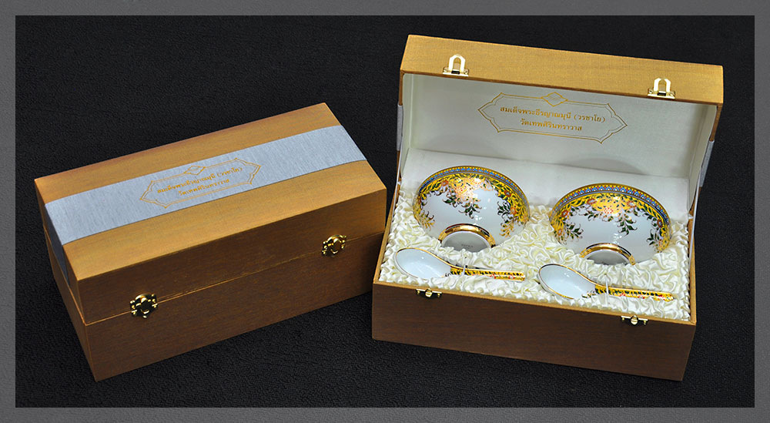
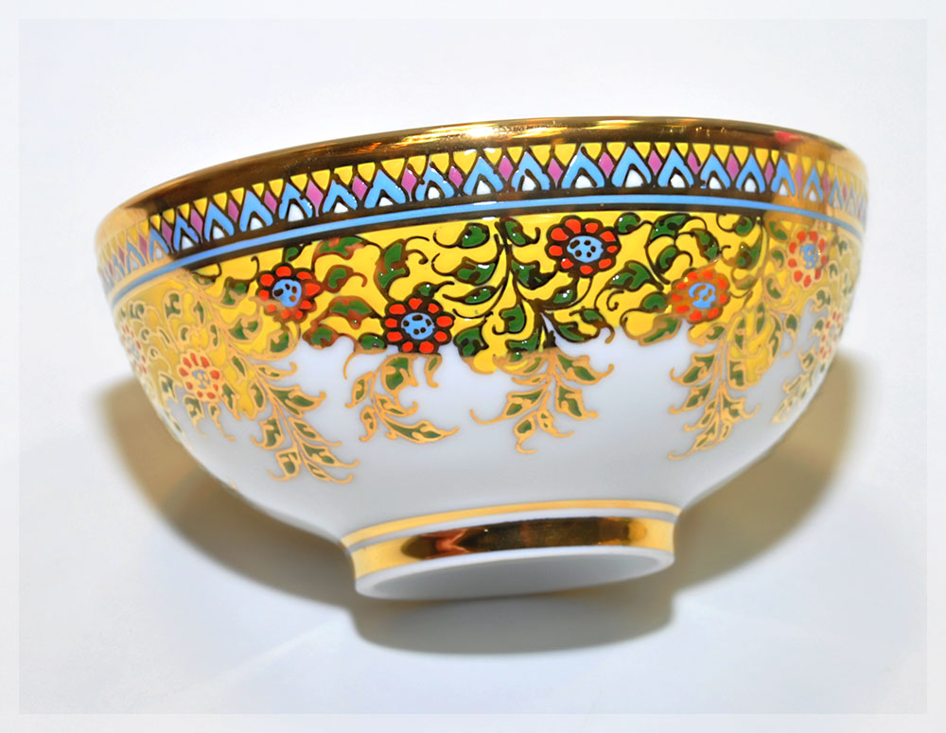
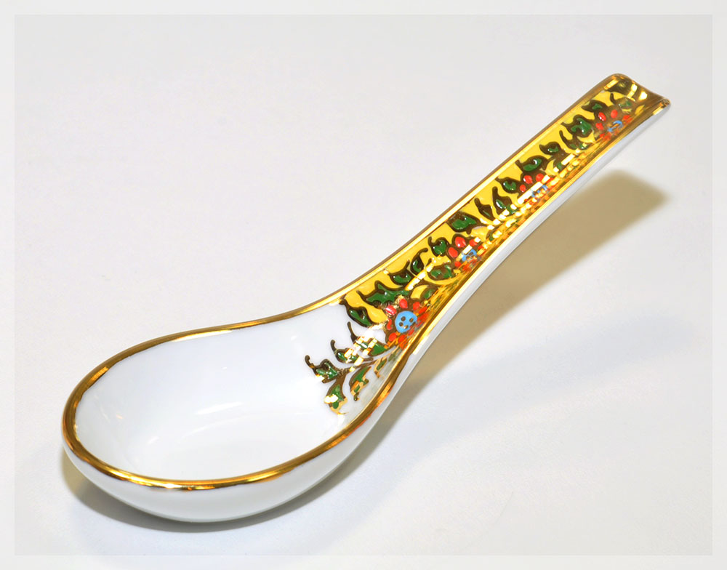
Double Bowl size 4.5 inch Price : 1,900 THB

Slide 8
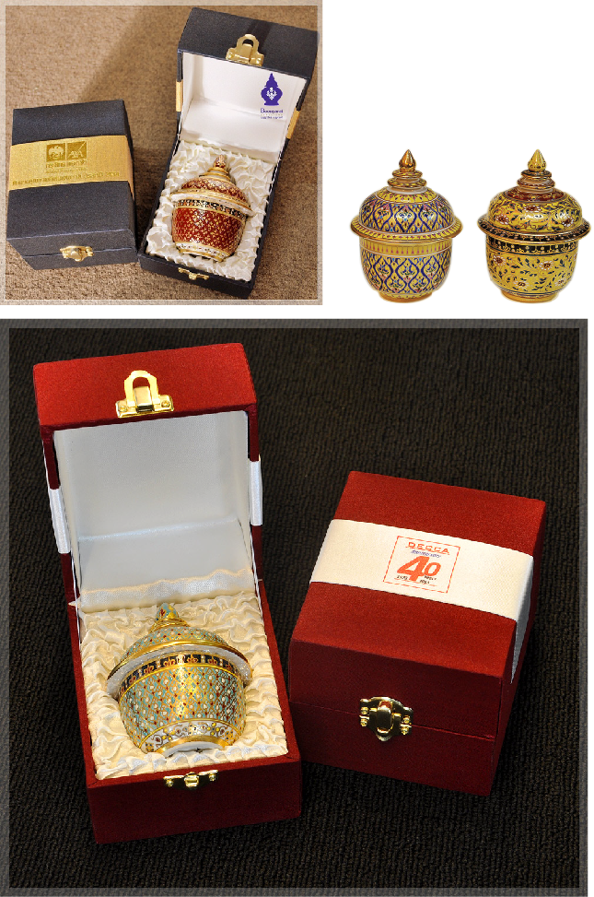
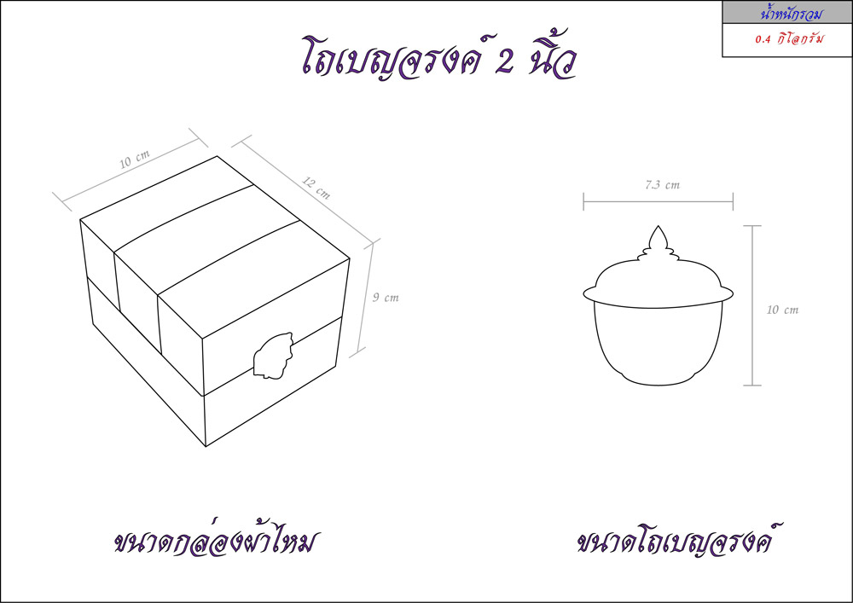
Thai bowl size 2 with lid inch Price : 460 THB

Slide 9
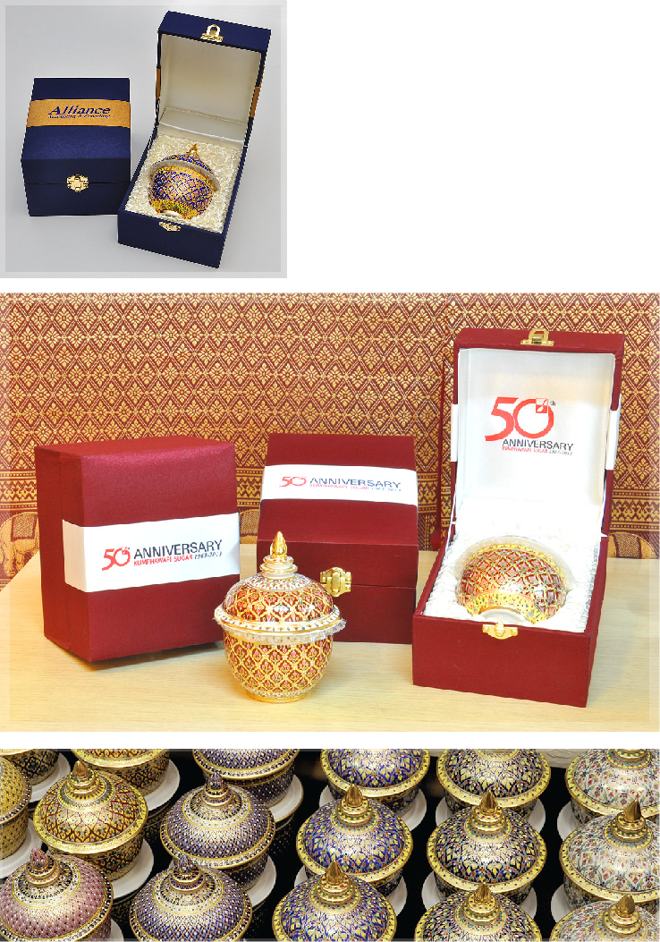
Thai bowl size 3 inch with lid Price : 870 THB

Slide 10
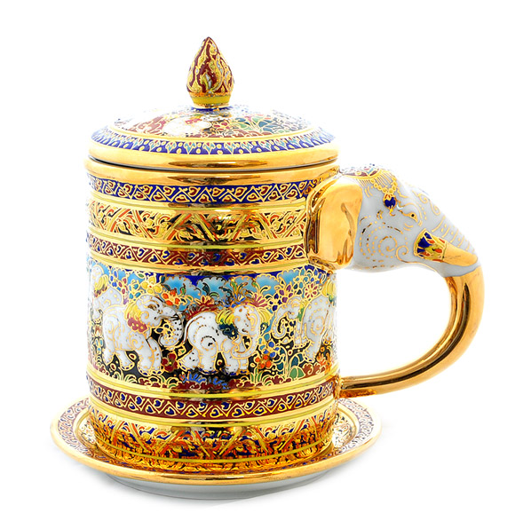
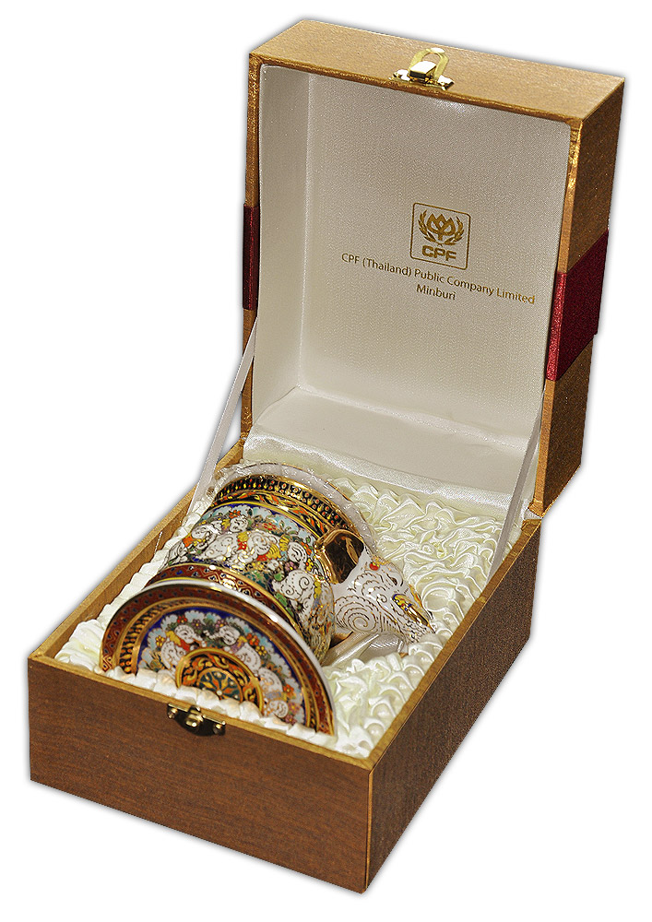
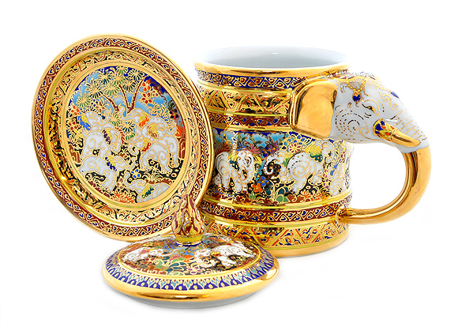
Mug Elephant ear Price : 1,350 THB

